Slide 1


Air Safety
DSC 640
Julia Cuellar

Slide 2
Introduction
Air travel is still profitable and by far the most preferred way to travel as well as US airlines tend to have safer travels compared to non-US airlines.

Slide 3
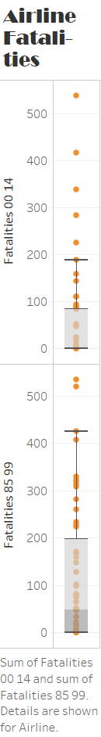
Based off the ‘Airline Fatalities’ graphic, more non-US airlines lean to a higher fatality rate compared to that of US airlines.

Slide 4
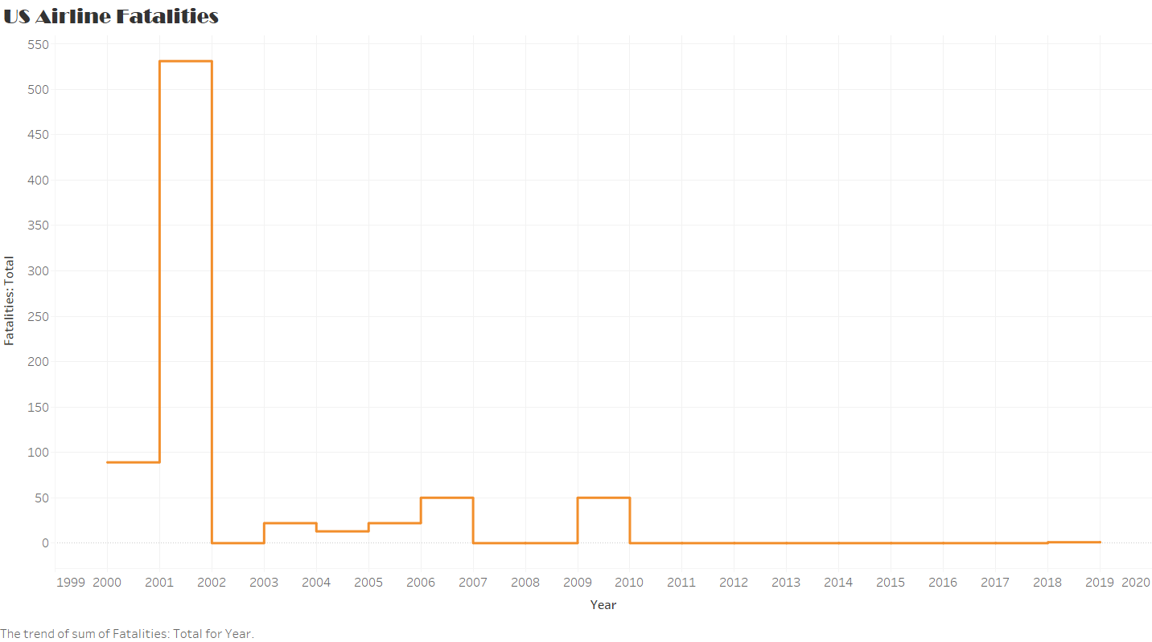
Yet, this does not deter from customers boarding US airways in the last 20 years for the ‘US Airline Fatalities’ graphic due to the low fatality rate occurring because of 9/11 but safety measures and precautions implemented from the TSA dwindle the fatality rate after 9/11 to lower than 50 the remaining 20 years.

Slide 5
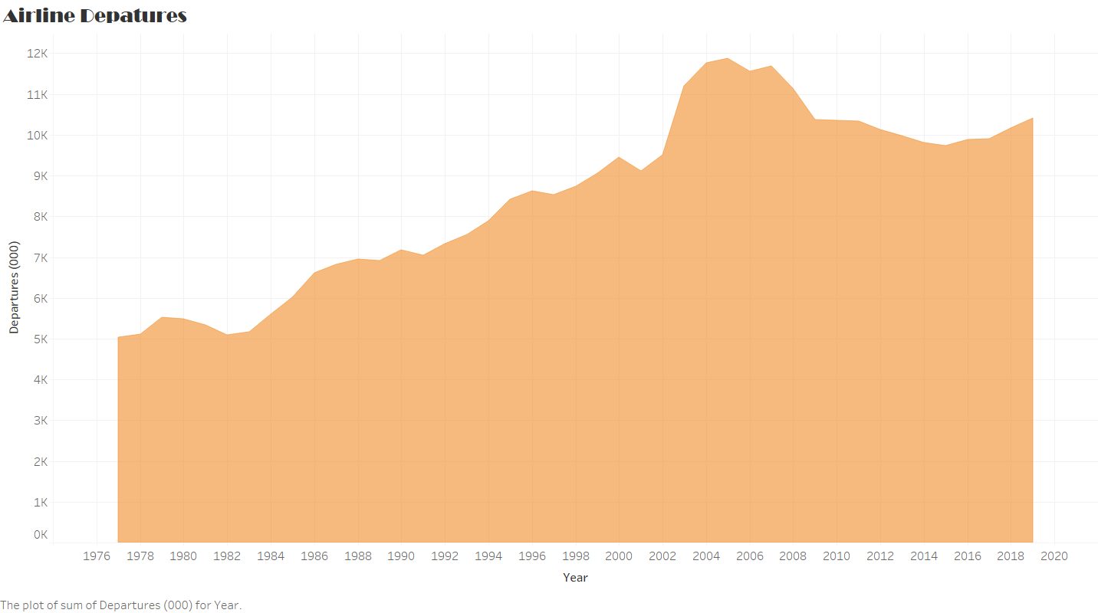
However, this also does not discourage customers from recurring their travel experience in preference to airways. This trend continues in the ‘Airline Departures’ graphic; with the booming pilgrimage known as “air travel” rising from 1977 to 2019, more departures transpired in the span of more than 40 years.

Slide 6
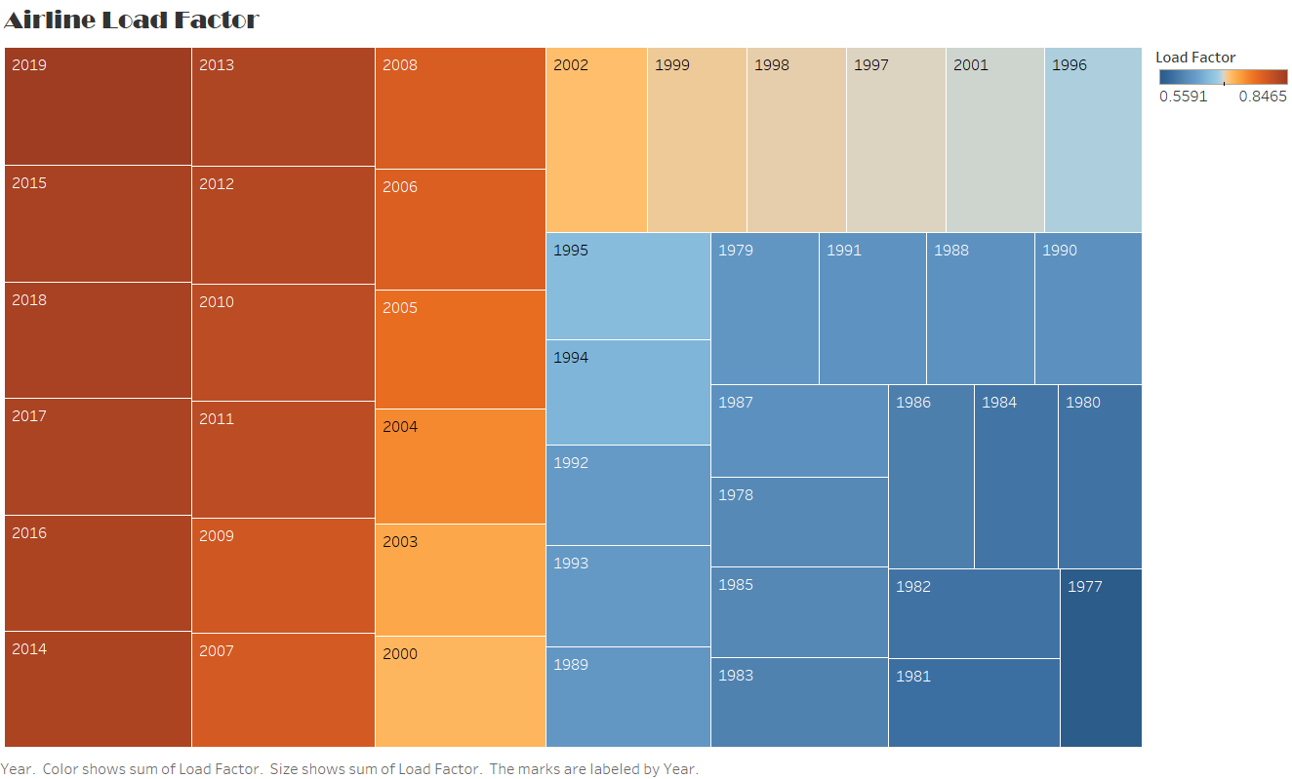
An akin occurrence transpires in the ‘Airline Load Factor’ graphic; in the span of more than 40 years, there is a rise in boarding airways over other travel preferences.

Slide 7
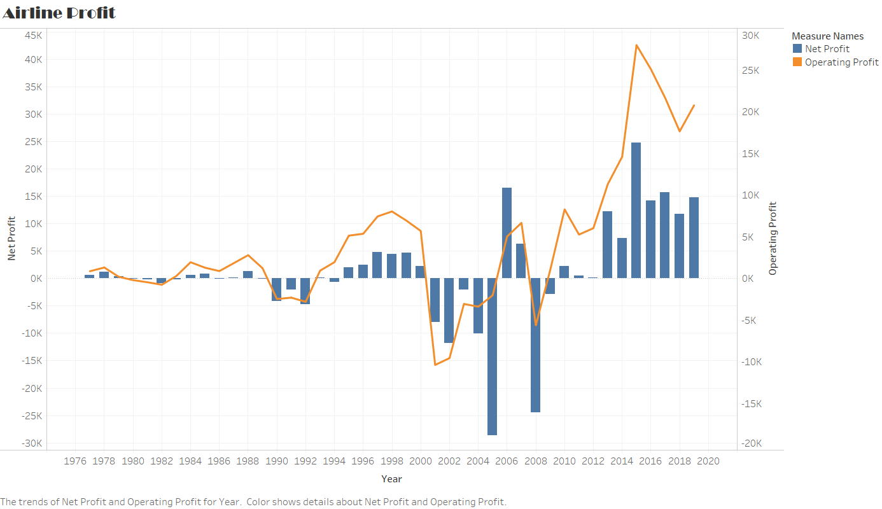
We acknowledge this direction in the ‘Airline Profit’ graphic; in the span of more than 40 years, there is an interconnected relationship between Operating Profit and Net Profit by the Net Profit only reclining for three events in time: once in the late 1980’s to mid-1990’s, another in the early 2000’s (effects of 9/11), and lastly, in the few years leading up to 2010 (global recession).

Slide 8
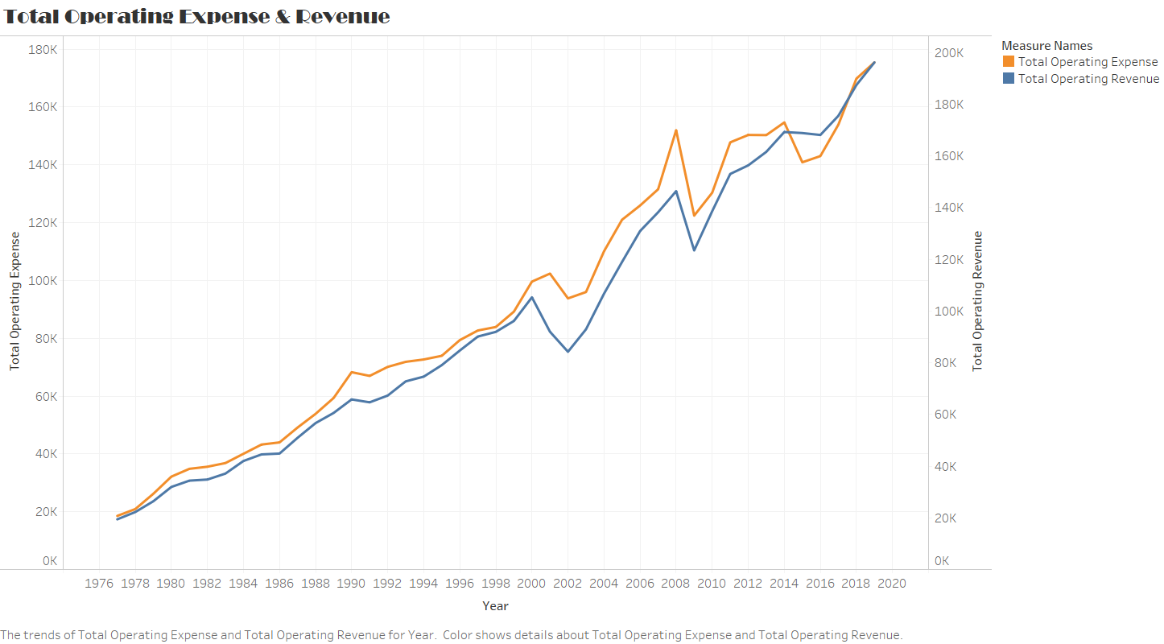
Finally, an alike development happens in the ‘Airline Operating Expense & Revenue’ graphic; in the timeframe of more than 40 years, there is an underlying relationship between expense and revenue to where revenue primarily exceeds expense, thus, consumers are still purchasing tickets for air travel.

Slide 9
Conclusion
To summarize, air travel is still a frequent option that patrons utilized whether with US-airlines (safer route) or non-US airlines (more vulnerable to fatalities) due to profitability, departures, load factor, and revenue. Thus, in conclusion, air travel is still a recurrent travel preference that patrons exploit domestically and internationally but will be operated in safer environments of US airlines and is still profitable even during times of crisis.

